Slide 1
Transfer Learning Emotion Recognition
By
THANUJ KUMAR GUMMADAVELLI
KARTHIK TAGORE
PAVAN KALYAN REDDY POCHUGARI
NAGA VENKATA AYYAPPA SWAMY MADAMALA

Slide 2
Abstract
• EEG data explored for reliable emotion recognition
• Pipeline planned from raw signals to predictions
• Dataset cleaned using filtering and segmentation steps
• Windows prepared for multiple learning model types
• ResNet50, 1D-CNN, LSTM, Random Forest applied
• Models trained, tested, and later fine-tuned
• Fine-tuning improved stability and learning behavior
• Confusion matrices examined prediction strengths and errors
• Project achieved full workflow from raw EEG to results
• Study revealed limits and potential of each model

Slide 3
Introduction
We aimed to explore how different machine-learning and deep-learning models interpret EEG signals.
The project involved preprocessing raw EEG data, applying filters, and segmenting signals into uniform windows.
Four models were implemented: ResNet50, 1D-CNN, LSTM, and Random Forest.
Each team member focused on one architecture from design to final evaluation.
We studied model behaviour before and after fine-tuning.
Confusion matrices were analyzed to understand class-level performance.
The project helped us learn how different models respond to EEG complexity.
Final results highlighted strengths, challenges, and improvement opportunities

Slide 4
ResNet50 Model: Thanuj Kumar Gummadavelli

Slide 5
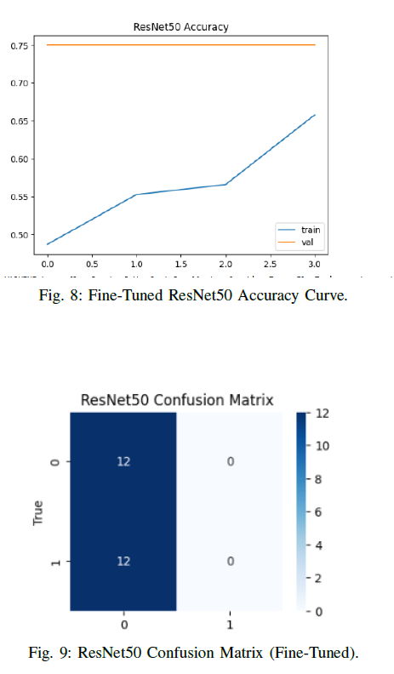
ResNet50 Model
My Contribution
Converted EEG windows into image-based representations.
Implemented the ResNet50 transfer-learning pipeline.
Configured preprocessing suitable for image-driven architectures.
Trained baseline ResNet50 and monitored accuracy trends.
Tuned deeper layers by adjusting learning rates and unfreezing blocks.
Generated accuracy curves and confusion matrices.
Evaluated limitations of transfer learning for EEG-derived images.
Documented challenges and prepared model performance reports.

Slide 6
What I Learned
Learned the difficulties of mapping EEG signals to image formats.
Understood how transfer-learning models behave with low-variance datasets.
Gained experience fine-tuning pre-trained architectures.
Studied how learning rates influence stability in deep models.
Learned to interpret overfitting patterns in accuracy plots.

Slide 7
Future Work
Explore spectrogram-based transformations for clearer patterns.
Test domain-specific models such as EEGNet adaptations.
Use larger datasets to support deeper layer unfreezing.
Apply regularization to reduce overfitting on EEG-image inputs.
Combine image and temporal features using hybrid models.
Incorporate frequency-domain features before image conversion.
Improve visualization of feature maps for EEG analysis.
Compare ResNet50 with EfficientNet or MobileNet variants.

Slide 8
1D-CNN: Karthik Tagore

Slide 9
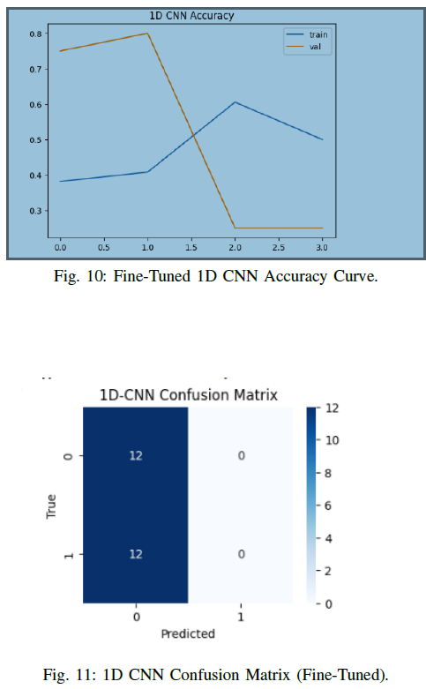
My Contribution (1D-CNN)
Designed the 1D-CNN architecture for EEG time-series inputs.
Selected kernel sizes, filter depths, and pooling configurations.
Trained baseline model and studied validation fluctuations.
Added extra convolution blocks during fine-tuning.
Implemented dropout to stabilize early-epoch learning behaviour.
Prepared accuracy curves and confusion-matrix results.
Compared 1D-CNN performance with ResNet50 and LSTM.
Documented sensitivity of CNNs to limited EEG samples.

Slide 10
What I Learned
Learned how convolution layers capture temporal EEG structure.
Understood the relationship between kernel width and signal dynamics.
Realized how dataset size affects CNN generalization.
Practiced tuning depth and filter count for signal stability.
Gained insight into vanishing and exploding activation issues.
Improved ability to diagnose overfitting through curve trends.
Learned how noise influences convolution output behaviour.
Understood model limitations for two-class EEG classification.

Slide 11
Future Thoughts and Extensions
Want to experiment with deeper temporal CNN stacks
Would explore frequency-band CNN features as input
Interested in combining CNNs with attention layers
Would test models on more subjects and emotions
Keen to study how noise reduction affects learning
Interested in developing end-to-end EEG classifiers
Hope to explore CNN-based real-time emotion systems

Slide 12
LSTM: Pavan Kalyan Reddy Pochugari

Slide 13
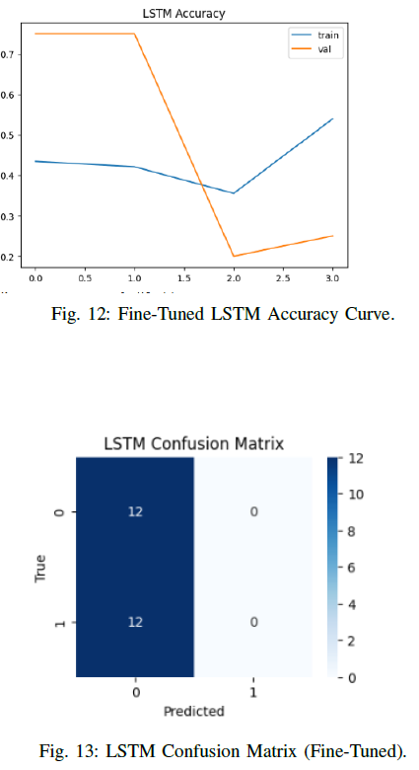
My Role in the Project
Designed and trained the LSTM architecture
Reshaped windows into sequential learning format
Tested stacked LSTM layers for pattern extraction
Tuned units, learning rates, and dropout settings
Analyzed separation between train and validation curves
Produced final accuracy plots and confusion results
Contributed insight on sequence-based EEG modeling

Slide 14
What I Learned
Understood how LSTMs handle long-range EEG patterns
Observed how easily sequential models overfit
Learned value of tuning dropout for stable training
Saw importance of clean, consistent time-series inputs
Improved understanding of model generalization issues
Learned to evaluate class balance through matrices
Gained experience refining recurrent architectures

Slide 15
Future Thoughts and Extensions
Would explore Bi-LSTM or GRU for deeper modeling
Interested in using attention layers for EEG focus
Would like to test emotion recognition across subjects
Want to explore longer windows for richer sequences
Curious about combining LSTM with CNN features
Wish to build interpretable models for brain rhythms
Interested in real-world EEG mental-state monitoring

Slide 16
Random Forest Model: Naga Venkata Ayyappa Swamy Madamala

Slide 17
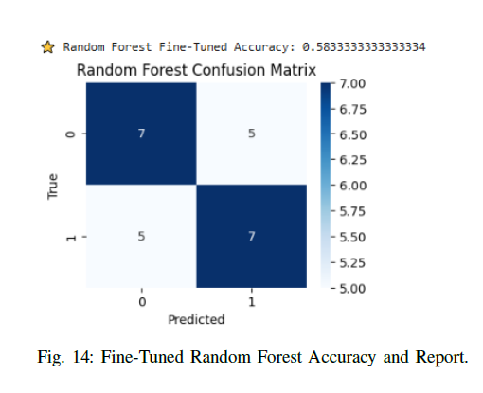
My Role in the Project
Prepared flattened EEG windows for classical modeling
Implemented the Random Forest baseline classifier
Tuned number of trees and depth constraints
Compared precision, recall, and class balance
Generated final classification reports and matrices
Evaluated how classical models differ from deep learning
Supported team with performance comparison table

Slide 18
What I Learned
Understood benefits of simpler models on small data
Saw how tree depth influences generalization behavior
Learned how confusion matrices reveal class issues
Realized preprocessing strongly affects classical models
Understood limits of feature-flattening for EEG
Improved tuning skills for structured ML algorithms
Gained insight into balancing accuracy with stability

Slide 19
Future Thoughts
Would explore feature selection for EEG data
Interested in testing ensemble methods beyond Random Forest
Would try combining classical ML with deep features
Curious about using wavelet features for emotion tasks
Want to expand training using multi-class labels
Wish to analyze how channel selection influences accuracy
Interested in building lightweight models for deployment

Slide 20
Team Reflection
Worked collaboratively across all stages of the project
Shared ideas to improve preprocessing and tuning
Combined strengths from different model approaches
Learned importance of communication and task planning
Compared models to understand EEG challenges
Gained technical and analytical skills as a team
Delivered a complete research workflow end-to-end
Worked collaboratively across all stages of the project
Shared ideas to improve preprocessing and tuning
Combined strengths from different model approaches
Learned importance of communication and task planning
Compared models to understand EEG challenges
Gained technical and analytical skills as a team
Delivered a complete research workflow end-to-end

Slide 21
Conclusion
From this project
We Gained practical experience handling complex EEG data
Built reliable preprocessing and segmentation pipeline
Compared diverse models across training conditions
Understood challenges of small EEG datasets
Saw fine-tuning improve accuracy and stability
Identified strengths of each learning method
Random Forest showed strongest balanced improvement
Future work needs richer data and deeper models

